Slide 1

Vigor Bond
By Aztech

Slide 2

Problem that we are trying to solve
About 27% of the total deaths in India are caused due to lack of medical attention given to patients in infirmaries around the country. Considering approximately 1.5 lakh people died in a year before the pandemic due to various mishaps, we can say that around 40,500 died only because they were not given the adequate treatment or were too late to reach an infirmary.
And now the situation has almost become four-fold. COVID-19 has not only increased the number of patients attending a hospital daily but has also added to the chaos and confusion. People now have more difficulty in choosing which hospital to take their friends and family to.
Which hospitals would have empty beds?, are their going to be any available doctors?, is the facility of buying medicines going to be available at a certain infirmary? Are some of the key problems that we desire to solve through our website.

Slide 3

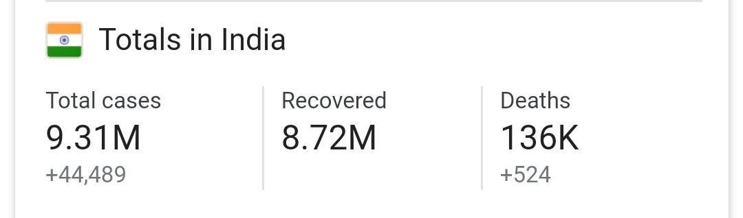
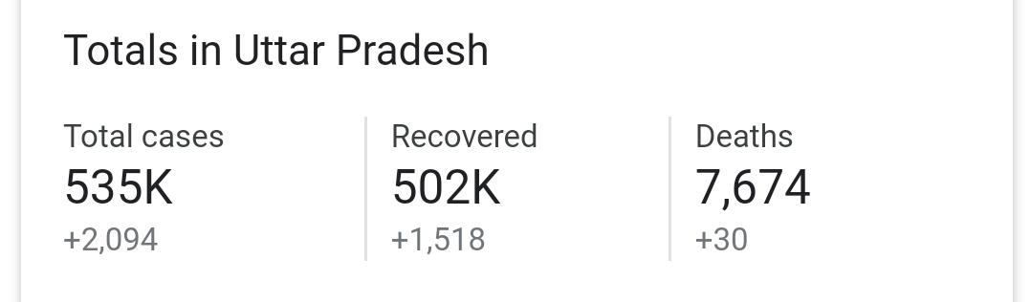
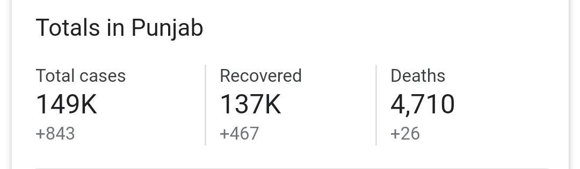
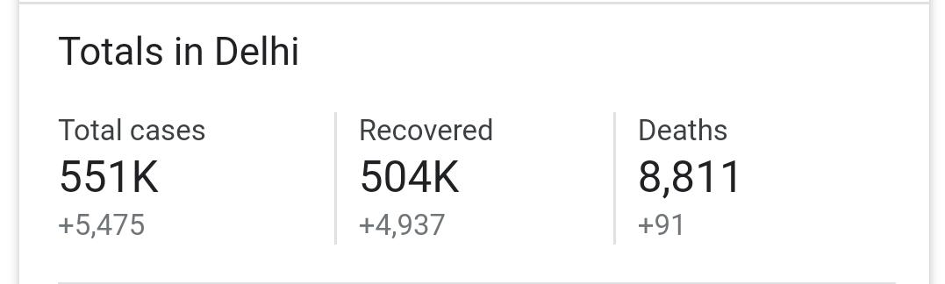
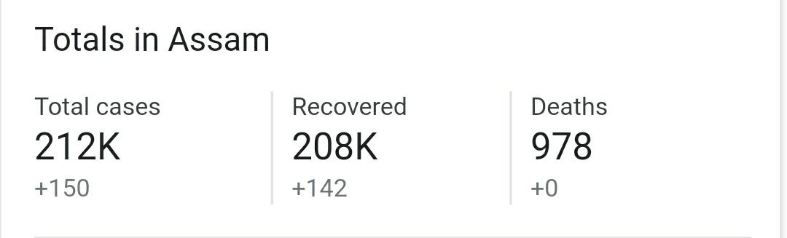
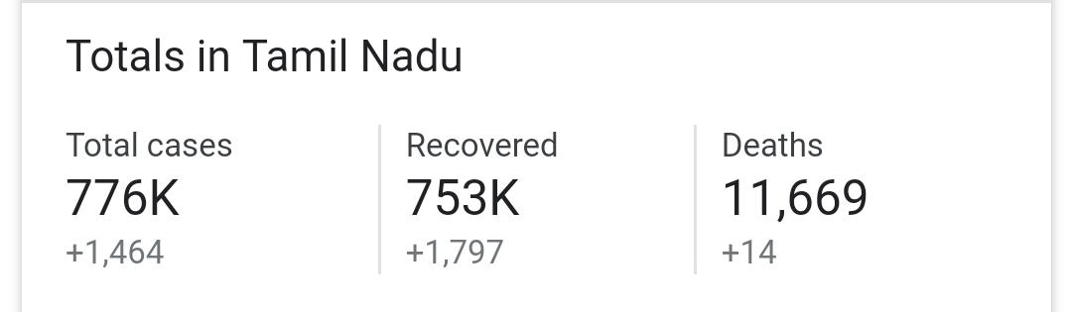
The present scenario:

Slide 4


This is just an approximate!!
The reason behind this is , many people who are not able to make it to the hospital due to unavailability of beds , die . And their deaths are not even registered .
People are preferring private hospitals ,and finding rooms there is a major task these days .
More than half of the covid-19 positive patient are not financially strong to afford its treatment from a good hospital .

Slide 5

What is actually happening(some examples):
80-year old Motiram Goyal’s family moved the Delhi high court to seek directions for Delhi government to provide him a bed with a ventilator in a government hospital, he succumbed to the disease. Though the Delhi government counsel told the court that they had arranged a bed the day they received an application and that he had died by the time they called him, questions are being asked as to why he could not get a bed in a Delhi government hospital and was kept without treatment in a non-COVID designated private hospital. After these developments, Delhi chief minister Arvind Kejriwal accused certain private hospitals in the city of turning away patients. But Goyal wasn’t the only one who was denied treatment. Another woman claims she lost father as he was denied admission
A 38-year-old non Covid-19 patient died on Thursday as the staff of Gulbarga Institute of Medical Sciences (GIMS) refused to admit due to unavailability of beds. The deceased has been identified as Ayub Patil, a resident of the city. He was taken to Gims as he was suffering from fever and breathlessness. "Though Ayub tested negative for Covid-19 during the antigen rapid test, he was not admitted to the hospital

Slide 6

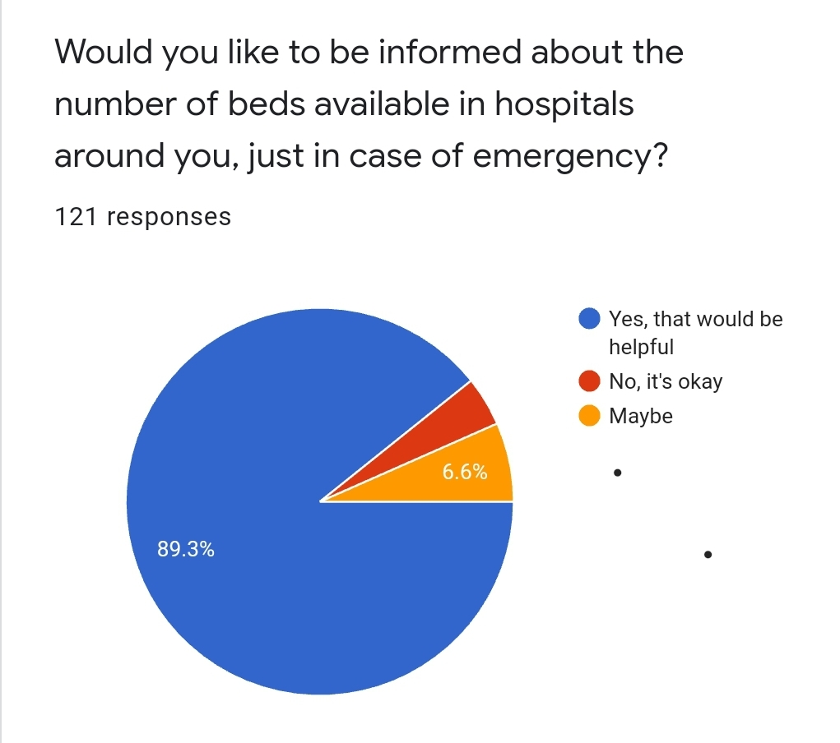
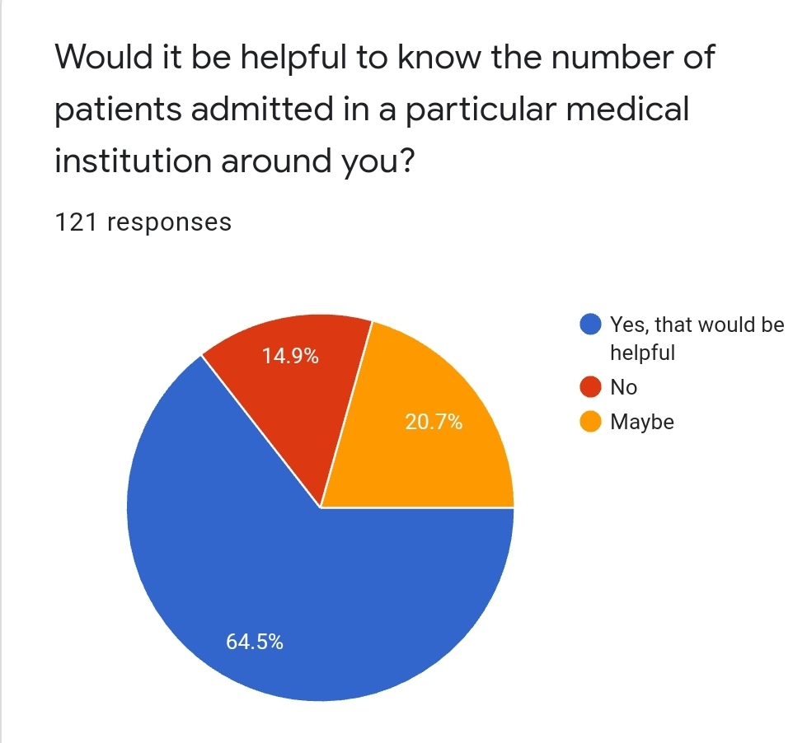
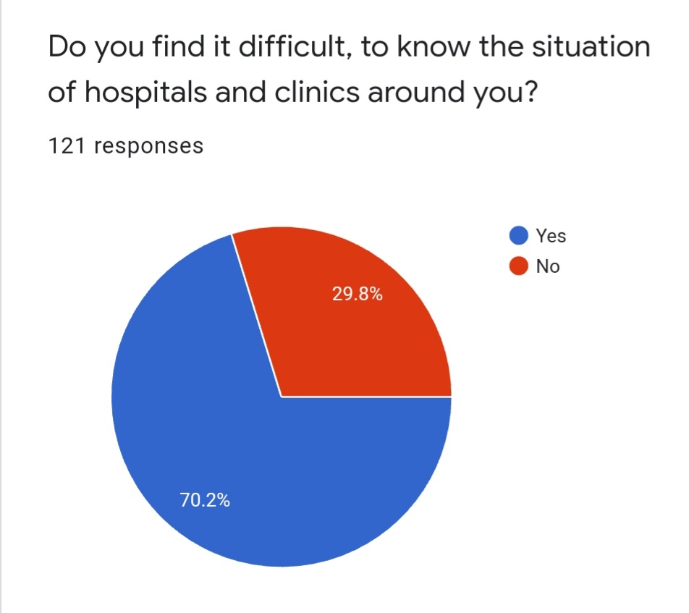
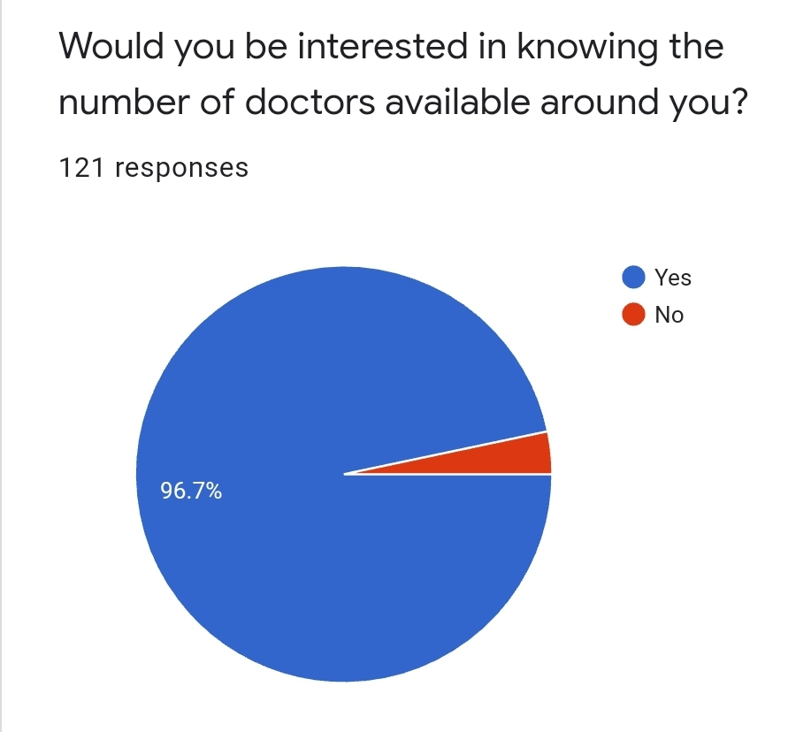
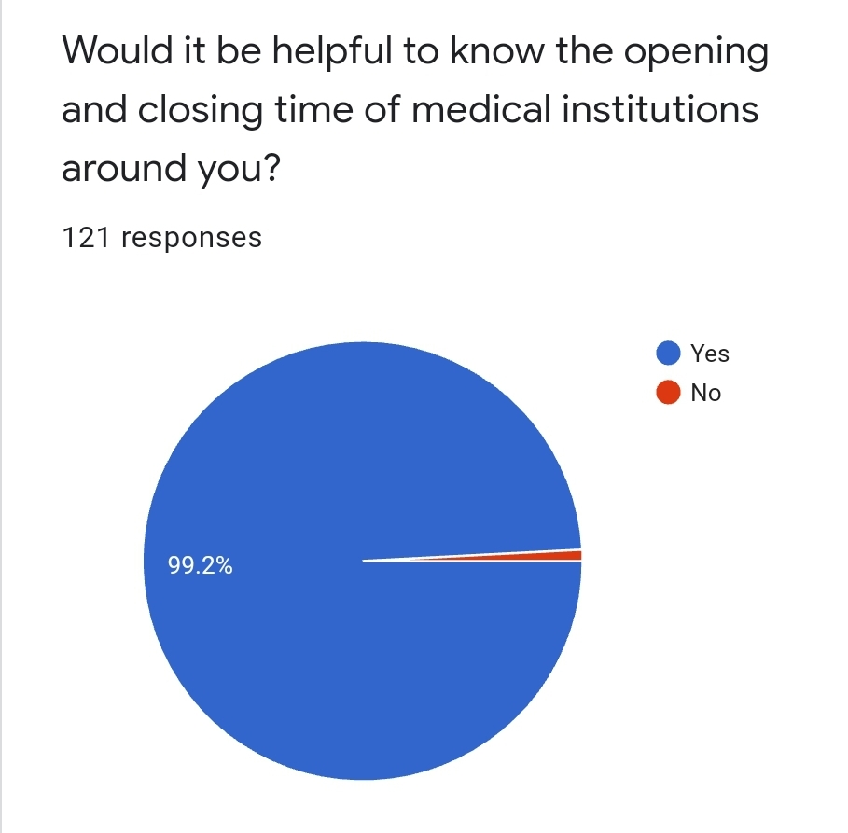
Who will this help?
We conducted a survey to check whether our idea is going to be effective at all or not. And these were the results:

Slide 7


How we intend to solve this problem?
We the members of Aztechs intend to make a functional website that would keep track of the number of:
The number of doctors available in one’s vicinity
Number of beds available in a particular infirmary
How many patients are admitted in a ward to check that proper maintenance of distance is there
Proper facilities are being provided or not.

Slide 8


